Slide 1
Passenger Behavior and Travel Pattern
Presented By
Vyomesh Jethava (18BCP152D)
B.Tech Semester-VIII
Under Guidance of
Mr. Keyul Modi, Infinity Transoft Solutions Pvt. Ltd. (External Guide)
Dr. Amitava Choudhury (Internal Guide)

Slide 2
Table Of Content
Objective
Motivation
Problem Statement
Software & Hardware Requirements
Introduction
Users of the System
Modules of the System
Methodology
ER-Diagram
Conclusion

Slide 3
Objective
This helps the company in handling networking part of the project.
Passenger behaviour and Travel Pattern will allow travellers to get better facilities and will to customer satisfaction.
This system is designed such that ultimately all customer will get best facilities available in market compare to other competitors.

Slide 4
Motivation
The motivation of this system is to provide a system with best networking system for our company.

Slide 5
Problem Statement
The organization shortlist the services to give to customers.
The shortlisted services undergo through a process of Testing it.
Passengers can give feedback based on the performance of their Trip.
Finally, the passengers are informed about their feedback.
This system can make the journey better and at end it can make customer more satisfied.

Slide 6



Users of The System
Admin
Travel
Agency
Passengers

Slide 7
Modules Of Our System
Role Management Module
Requisition Request Module
Request Approval Module
Data Sourcing Module
Candidate Acquisition Module
Interview Scheduling Module

Slide 8
Methodology

Slide 9
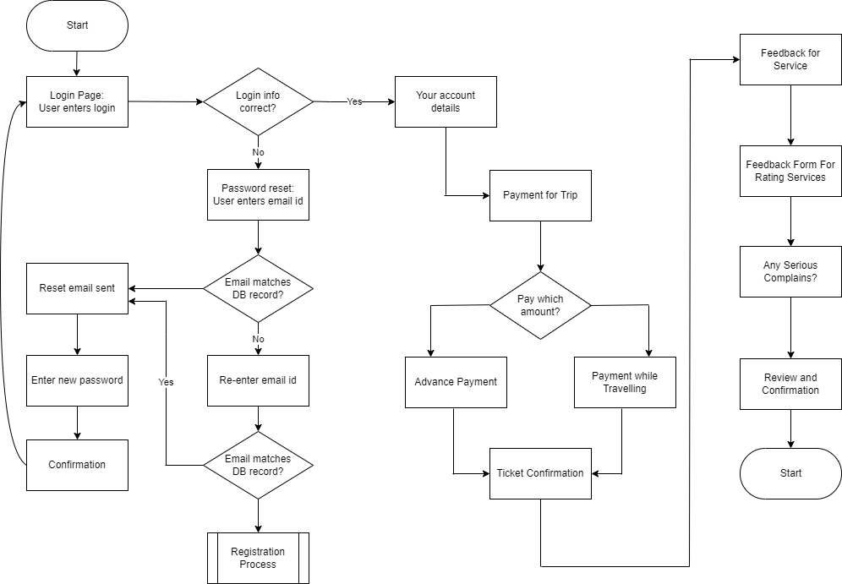

Slide 10
ER-Diagram

Slide 12
Working

Slide 13
Creation and maintenance of user accounts and contact lists.
Troubleshooting/ helpdesk regarding problems with employees computers.
Use of data transfer and system security diagnostic tools to monitor and address problems within the organisations.
Track data of passengers booking.

Slide 14
Working Platform

Slide 15
Windows 7 and Windows Server 2000
Symantec Antivirus Corporate Edition 2003 and Firewall System Diagnostic Tool
Microsoft Active X Directory and Microsoft Exchange Mail

Slide 16
UI Screen

Slide 17
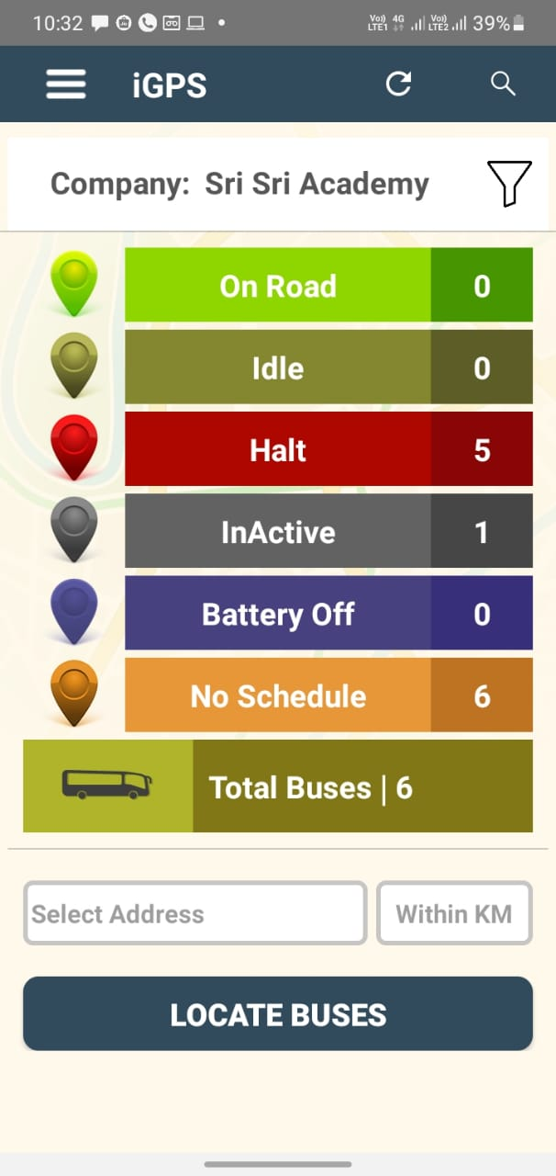

Slide 18
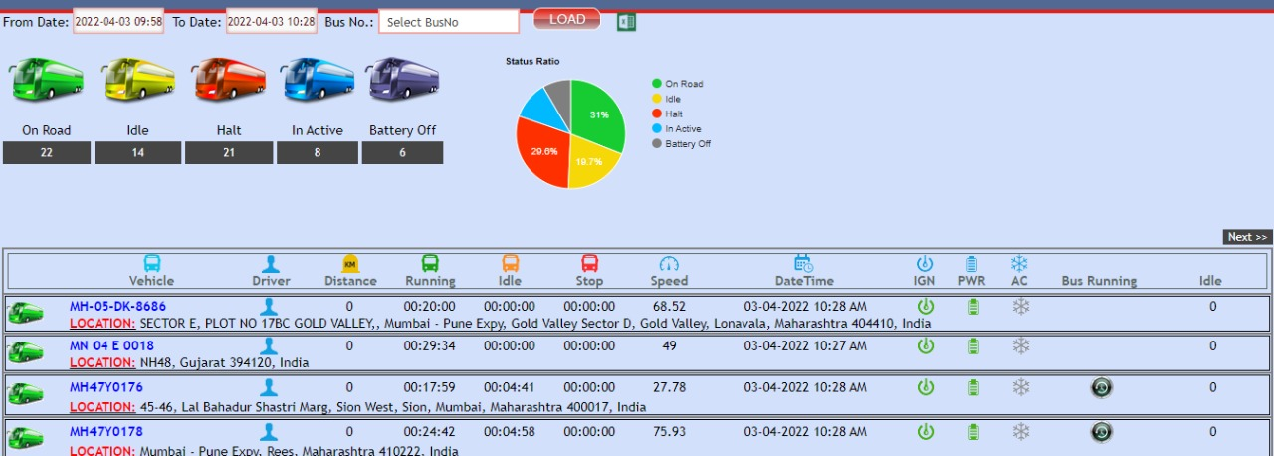

Slide 19
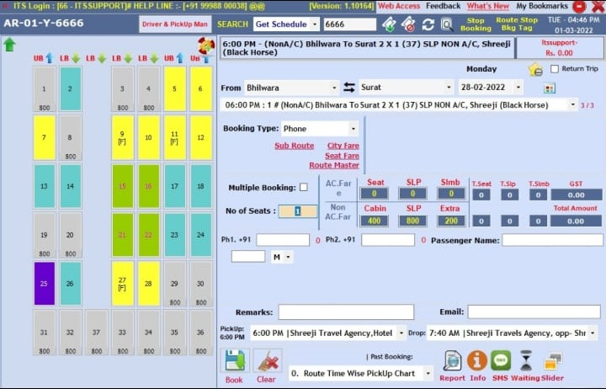

Slide 20
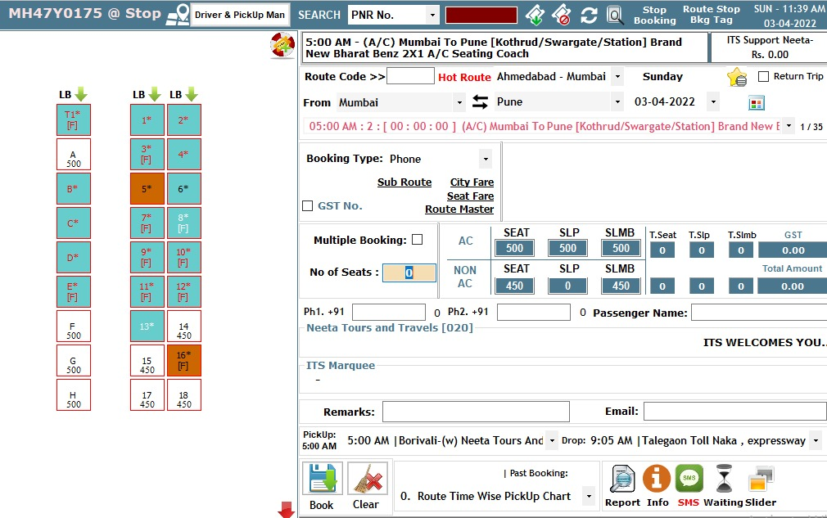

Slide 21
All Clients From Different Products

Slide 22


Slide 23
Conclusion

Slide 24
From a proper analysis of positive points and constraints on the component, it can be safely concluded that the product is a highly efficient.
This application is working properly and meeting to all user requirements with dedicated server and best networking facilities.
This component can be easily used for many travelling companies.

Slide 25
THANKS!
Any questions?

